Slide 1
STORE SALES FORECASTING
Group Members:
Shalvi Deshmukh - xn7935
Notes:
Hello and welcome! My name is Shalvi, Priyanka, Pallavi, Bhavitha and we are group number 3.
Our project is about 'Store Sales Forecasting'.
In this project we help businesses to estimate future revenue by predicting how much of a product or service will set in next week, month or year. So let's dive right in.

Slide 2
MOTIVATION
ANALYZE
DECISION MAKING
Predict future store sales for informed retail decisions.
Mine data, analyze time series for key sales drivers.
TEAMWORK
PATTERNS
Multivariate analysis unveils store sales influencers.
Sales data has valuable temporal patterns.
FORECASTING
REAL WORLD APPLICATION
Accurate sales forecasting maximizes overall business profitability
Notes:
Our motivation includes Decision Making, Pattern, Forecasting, Analyze, Teamwork, Real World Application.

Slide 3
Research Question
How can data mining and machine learning models be leveraged to forecast store sales accurately across various time periods using the provided multivariate dataset?
JUPTER
Jupiter is a gas giant and the biggest planet
SATURN
Saturn is composed of hydrogen and helium
NEPTUNE
Venus has a beautiful name and is the second planet
Neptune is the farthest planet from the Sun

Slide 4
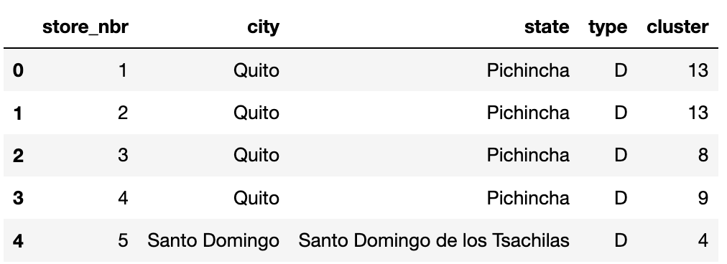
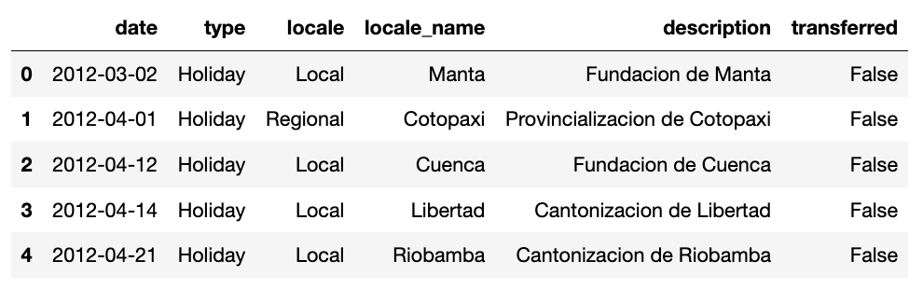
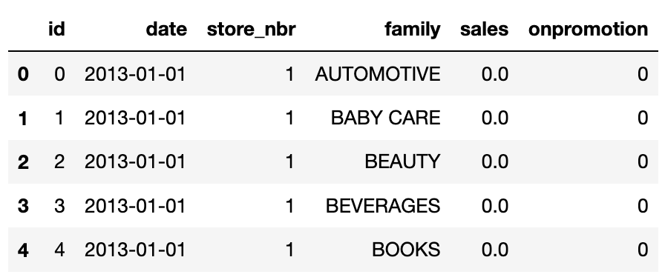
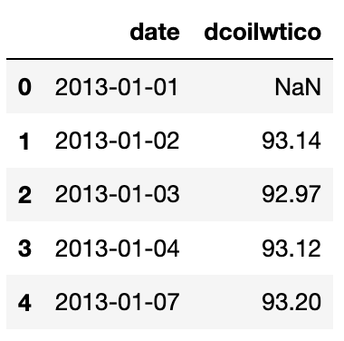
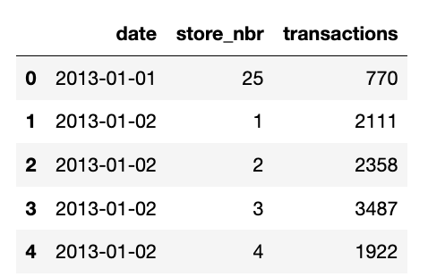
DATA SET
STORE
HOLIDAYS & EVENTS
TRAIN
OIL PRICES
TRANSACTION
Notes:
We have taken 5 datasets.
Stores data gives some information about stores such as city, state, type, cluster.
Train data contains time series of the stores and the product families combination. The sales column gives the total sales for a product family at a particular store at a given date.
Transaction data is highly correlated with train's sales column. You can understand the sales patterns of the stores.
Oil Price data is another data which which is critical., it will help us to understand which product families are affected in positive or negative way by oil price.
Holidays and events data is quite valuable to understand past sales, trend and seasonality effect.

Slide 5
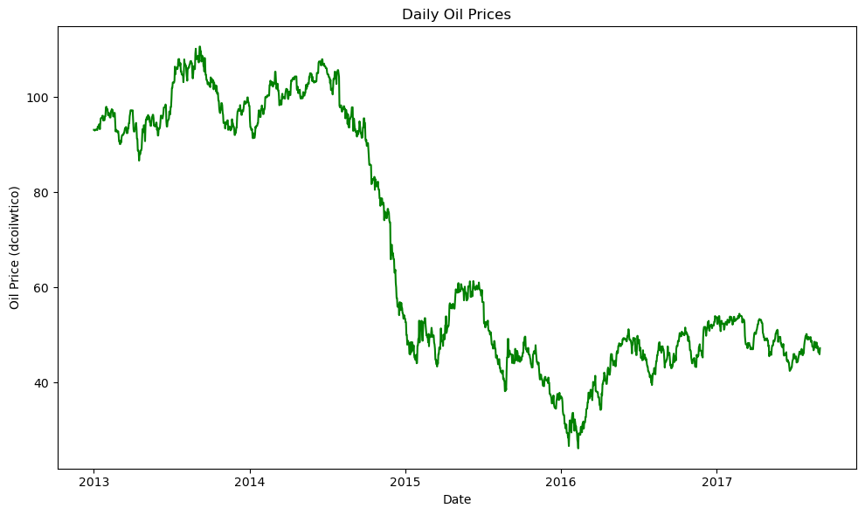
Notes:
I will be taking you through some of the visuals that have been derived from our data. This is a line plot for all the oil prices against the respective year.
We had some missing values in oil prices data which were interpolated by estimating values based on nearby data points.
Also, looking at the daily oil prices, we noticed a big drop when the prices were around 70. So, we engineered a binary feature to mark times when oil prices went above 70 and below. We’ll explain its importance in the later slides.

Slide 6
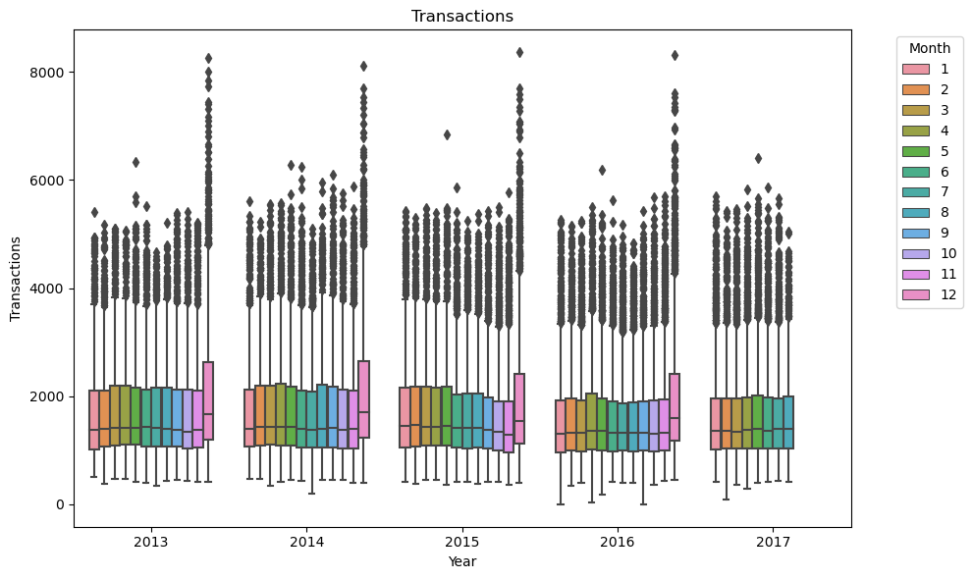
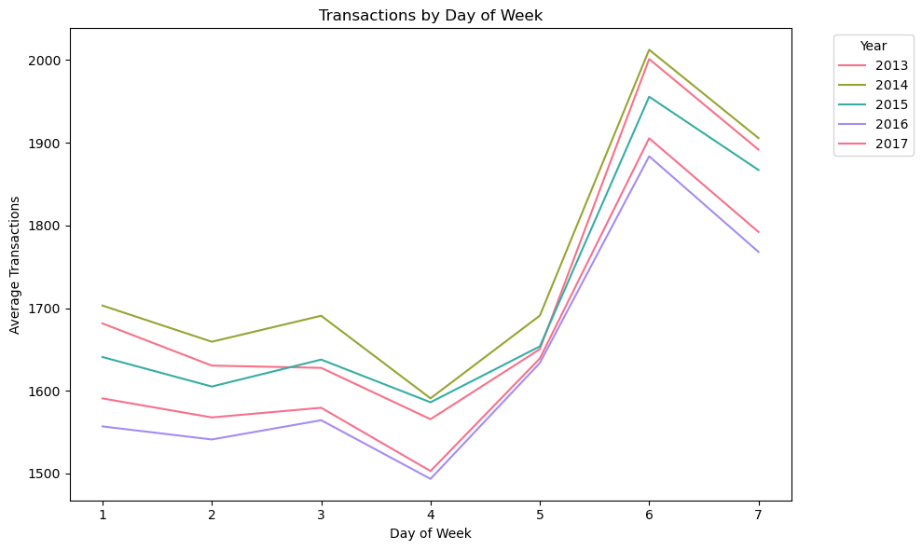
Notes:
Here we have analyzed the patterns in the transaction data over year, month and day of the week. You can see that the number of transactions happening in a year is always higher towards the end, in the month of December. This could mean that the holidays may be impacting the transactions. Also in the next plot, you could see how the number of transactions vary over the week. We see a hike on Saturday and a slight dip on Sunday, but it is still considerably higher than the rest of the days of the week.

Slide 7
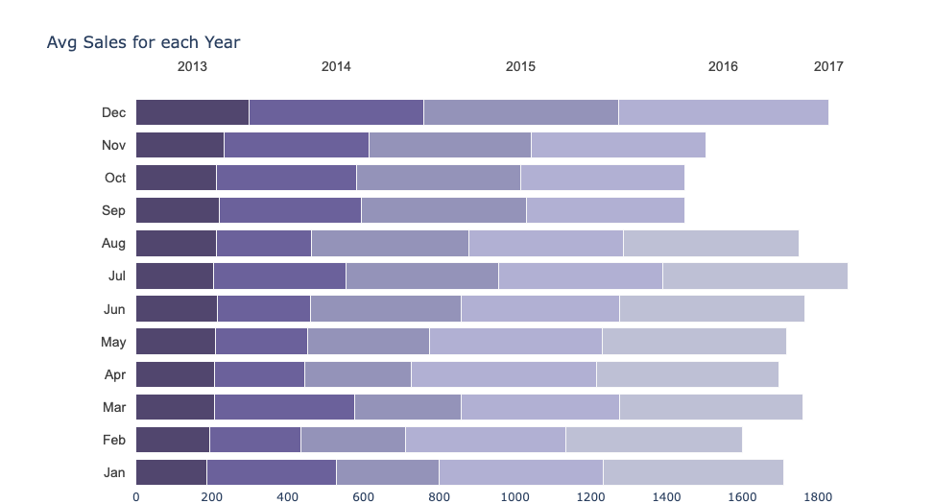
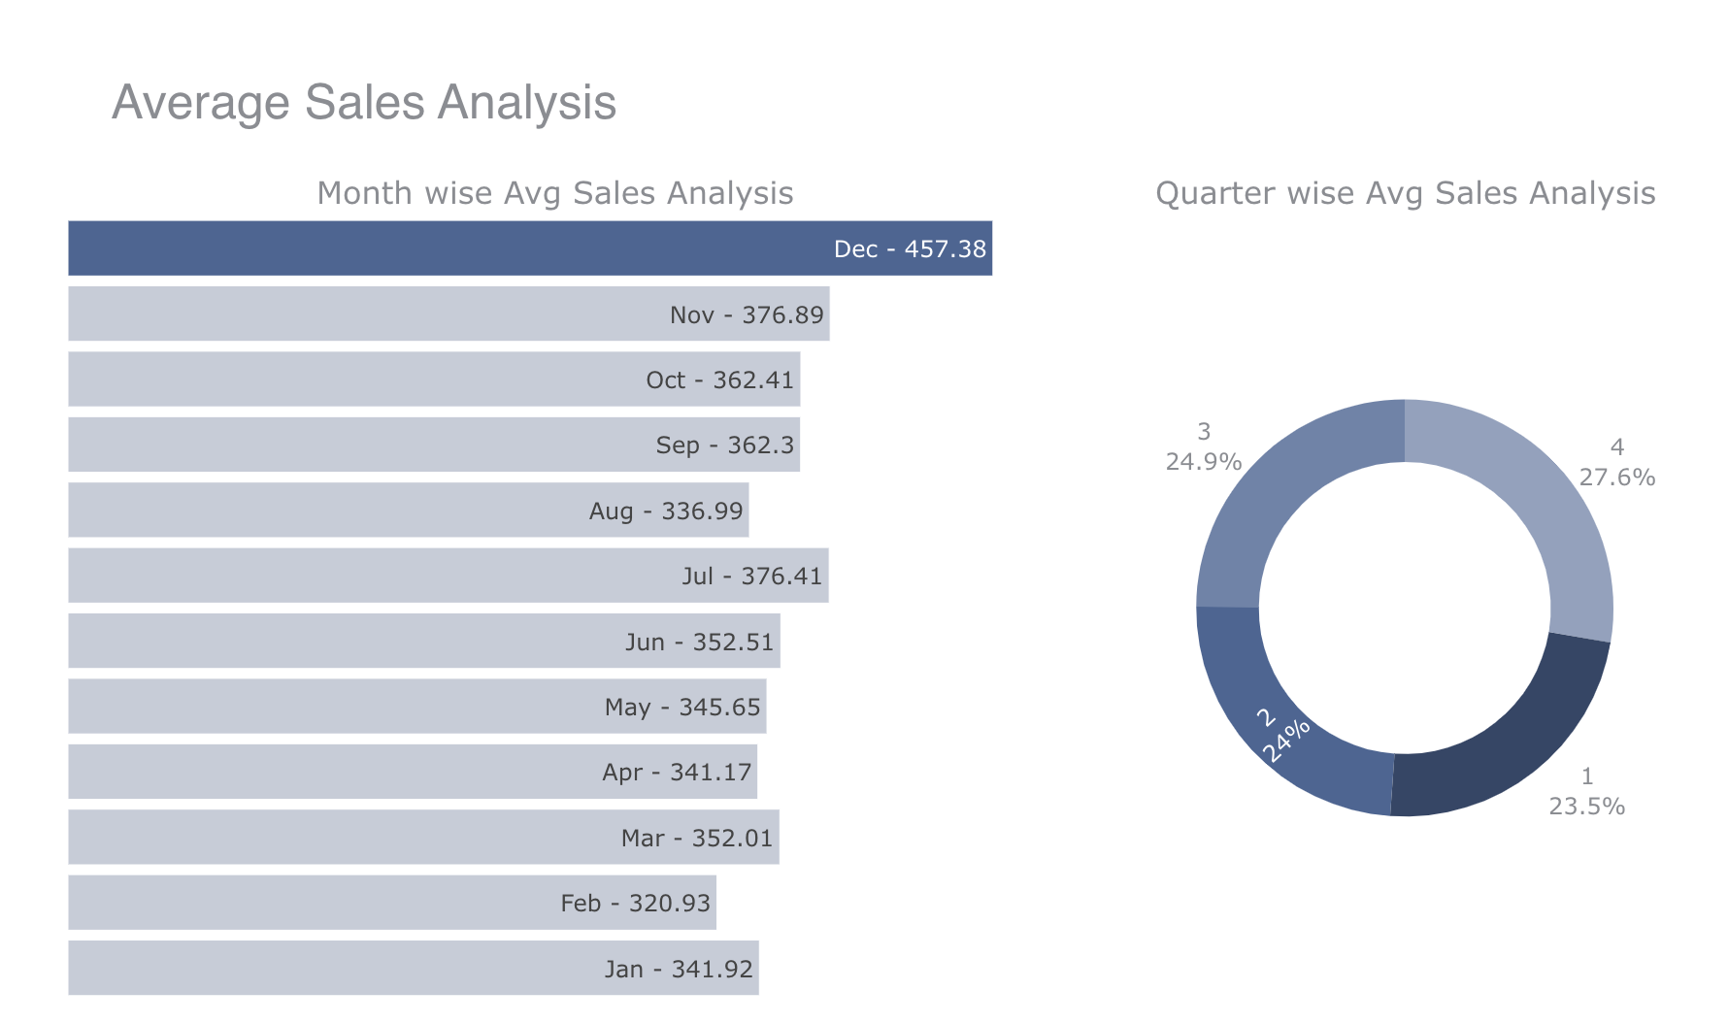
Notes:
The next set of variable we have is our sales. Here you will see the sales data over time. From the first plot it is evident that the average sales is very high during the end of the year. You can see our month wise average sales chart where it shows that sales were the highest in December which could indicate a possible impact from holiday seasons.

Slide 8
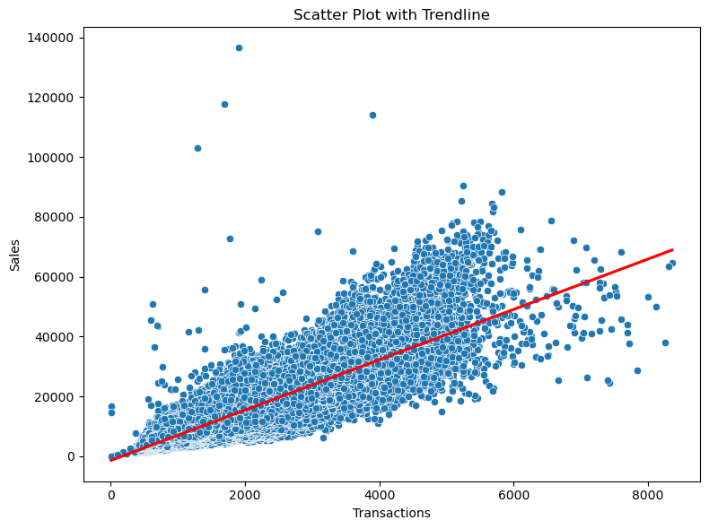
Notes:
We've presented a scatter plot showing the relationship between sales and transactions.
You can see it has a positive linear relationship, as indicated by the upward trend line which indicates a correlation where higher transactions tend to align with increased sales.

Slide 9
Model Used
RANDOM FOREST :
Our project involves data preprocessing, exploratory data analysis, and model building using a Random Forest Regressor.
Random Forest Regressor is used to build a predictive model for sales. Label encoding is performed on categorical features, and the model is trained on the training set ('train') and tested on the test set ('test’).
Model evaluation is done using Root Mean Squared Log Error (RMSLE) as the evaluation metric, comparing predicted sales with actual sales.
Notes:
We are using the Random forest regressor in our project for model building.
As we know, it is a Machine learning algorithm which is specifically designed for the regression tasks
This is also an extension of Random forest algorithm.
These models are used because of their ability to handle the complex regression tasks especially for sales forecasting.
This model is robust to noisy data and outliers due to its ensemble nature so Outliers are less likely to have a significant impact on the overall model.
Implementation wise also it is straight forward, it requires minimal hyper parameter tuning compared to other models.
Although it requires that the time series data be transformed into Supervised learning so here, we have joined oil + holidays + stores to our sales over date and we are training the model with this data.

Slide 10
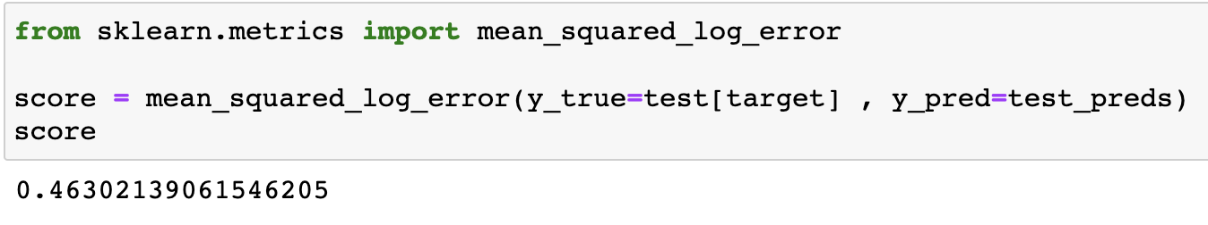
Our Findings
Root Mean Squared Log Error (RMSLE) :
RMSLE without oil price raw feature : 0.5253 RMSLE with oil price as raw feature : 0.650
RMSLE with feature engineered oil price feature ( > 70, <=70) : 0.4630
Notes:
We are doing the Model evaluation using Root mean squared log error to predict the accuracy, It is mostly used in regression problems.
We may have the question why we used this metric instead of Root Mean Square Error?
Because we have many advantages like this metric is scale invariant meaning it does not depend on the target variable.
It also encourages relative accuracy where we consider the relative difference between the predicted and actual values than the absolute difference.
The ideal value is 0. A lower the value indicates the better performance.

Slide 11
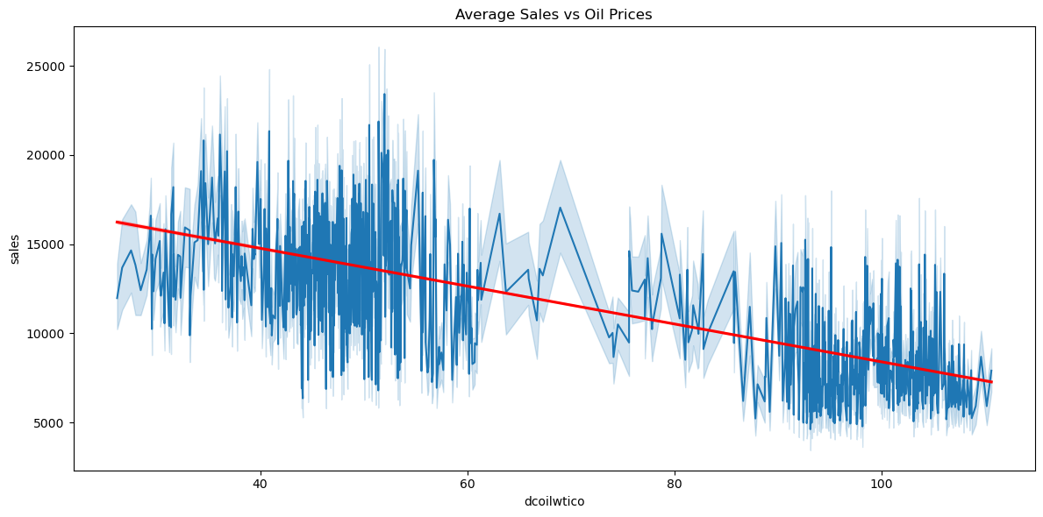
Notes:
If you see this plot, when daily oil price is under 70, there are more avg sales in the data and we can see for above 70 the average sales are decreasing.
There are 2 cluster here one is over 70 and the other is under 70..
We could clearly see that there is a dependency of the sales over the oil prices.
Initially we fed the model with data not containing oil prices. We got RMSLE value as 0.52 which is not that great.
Next, we included the data with raw oil prices and fed to the model. Instead of getting an improved RMSLE value we got a higher value I.e 0.62 which was even worse.
Lastly, we introduced binary oil feature to the model(over 70, under 70) and the value improved to 0.46 which is pretty decent. Anything below 0.5 is considered as good.
.

Slide 12
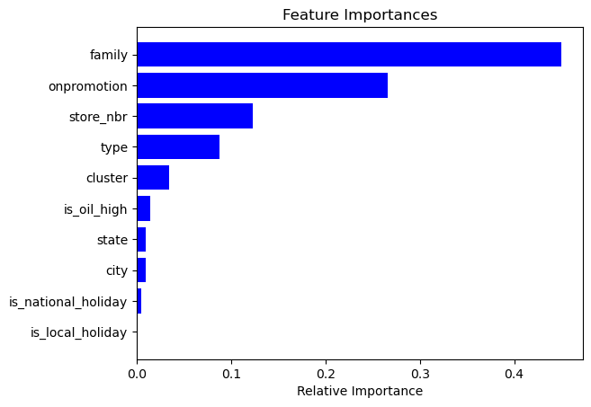
Feature importance is determined using the Random Forest model, and the relative importance of different features is visualized
Notes:
After Modeling segment, let’s see how much important a feature is to the outcome.
Significant variables according to random forest feature importance are family and onpromotion.
So the type of product sold and the promotion of that product seems to have impact to our model.

Slide 13
Challenges
Comprehend Features
Data Prep challenges
Assume
Adapt to real-world dataset dynamics
ENGAGE
Notes:
After thoroughly comprehending the intricacies of each feature, a comprehensive understanding of its significance, and potential impacted on the overall analytical process
Data preparation involved handling missing values, creating new necessary features, understand the new patters through graphs.
And assume Data readiness.
After the data preparation we assume it’s ready for modeling. But after modeling we run through estimating error. Where in we understand that can be improved by feature engineering and again we re model data and this goes on until we reach a propere estimate.
Adapting to real-world dataset dynamics-
We need to Adjust our assumptions for optimal performance.

Slide 14
What we learnt
In real-world data analysis, cleaning and handling missing data proved time-consuming.
Surprisingly, data transformations like normalization, standardization had minimal impact on Random Forest model performance.
Using RMSLE helped in getting more accurate reflection of the errors, as it measures the relative differences in the predictions and actual values.
Notes:
1. Data preparation consumes a lot of time.
2. data transformations like normalization, standardization had minimal impact on Random Forest model performance
3. RMSLE helps in predicting the relative error between predicted and actual value and the scale of the error is not significant.

Slide 15
Feel free to share your thoughts or ask any questions you might have?
Notes:
Thank you for your time and attention. Please feel free to drop your comments and feedbacks, they will immensely contribute to refining our project.

